Slide 1
ASP.NET MVC CORE
Instructor: Edwin oduor

Slide 2

Quote of the day

Slide 3
Lesson objectives
Core Identity
Adding Core Identity into a project
User Registration using Entity Core Identity

Slide 4
Lesson pre-requisites
In order to take full advantage of this section you need to have the following;
Computer with Visual Studio Installed.
Stable Network Connection.

Slide 5
Training methods and extra readings
TRAINING METHODS FOR THIS LESSON
EXTRA READINGS
Lecturing Method – This is the main method of training to be adopted in this lesson with illustrations and practical coding examples.
Discussion Method - This method will be adopted periodically whereby learning will be derived principally from the students brainstorming together, rather than from the trainer. Three main types of discussions will be used:
Directed discussion
Developmental discussion
Problem-Solving discussion
Home and Learn C#

Slide 6
Core identity

Slide 7
What is Core identity?

Slide 8
It is a built in Member-ship system that allows us to Create, Read, Update and Delete user accounts and Implement security features for our systems that we are creating.
It is concerned with account confirmation
Authentication and authorization
Password Recovery
Two-factor authentication with SMS, and others.

Slide 9
How to add Core identity in our project?

Slide 10


To Add Core Identity the first thing is to add it in our project, using the Nuget manager, search for “Microsoft.aspnetcore.Identity.EntityFrameWorkcore” >> Install the package based on the version that you are using. >> Next in the DbContext class we need to inherit from IdentityDbContext.
Next add services in the startup file, configure services method.
Add Authentication Middle ware in the start up file configure method, below static files.

Slide 11
Once all that is done we need to add a migration and give it a name “AddingCoreIdentity” then update the database.
When the migrations is done tables are going to be created for us, to make it possible to register users and make a login.

Slide 12
User registration

Slide 13
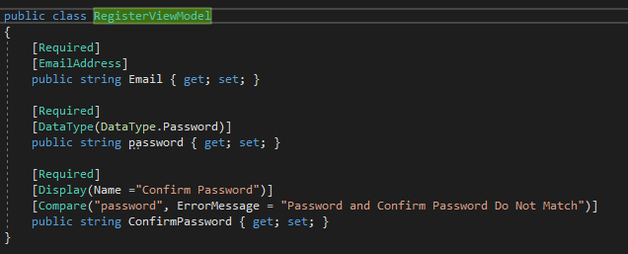
To register a user will create a model first will create a folder in the model folder(ViewModel) and then create a model give it the name RegisterViewModel
Inside the model will have the following fields.

Slide 14


Next will create a controller, give it the name AccountsController the Action will give it the name Register
>> Create an empty razor view from the Register Action and give it the name register.
Before using above code in the view that we have just created “register” we need to go to the _ViewImports.cshtml and write the following so that we can now use the above code.
This is to tell our program that we want to use the register view model and to use the model it is found in the Models folder, inside it there is another folderViewModel.

Slide 15
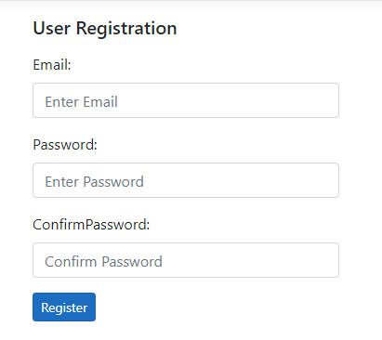
The register View should look like this. (Exercise)

Slide 16
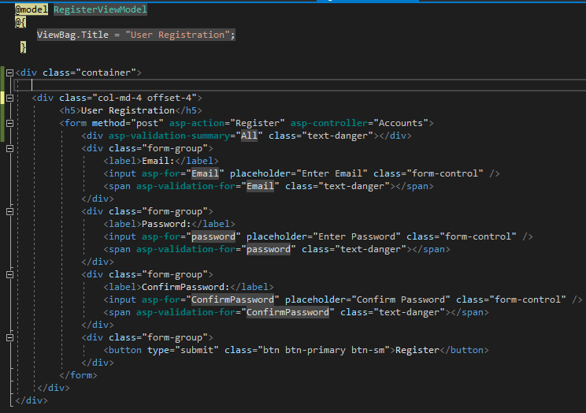
Code to give us the out put shown in the previous slide.

Slide 17
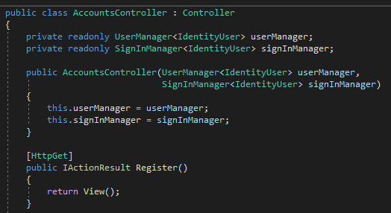
Next is to go back to the AccountsRegister, the Register Action will decorate it with get method. In the AccountsController we have two private read only properties that is userManager and signInManager.

Slide 18
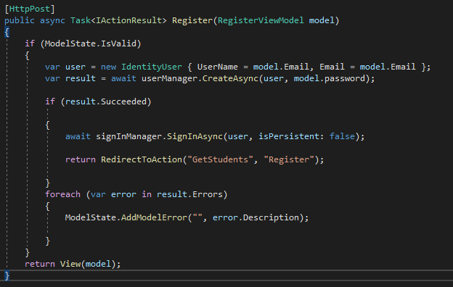
In the Register method, the one that will decorate with post method this is what will have. In our code below we have userManager.CreateAsync the method is an Async method therefore we need to await it and our IActionResult we need to make it Async.
Session cookie

Slide 19
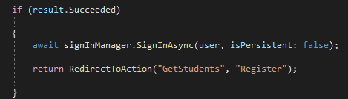
This is part of the previous code in the previous slide.
If statement is used if a user is created successfully then will pass in the user variable in the method and second part we are creating a session cookie.
There are two types of cookies a) Session Cookie b) Persistent Cookie
Session Cookie – The cookie is usually lost when the browser window is closed.
Persistent Cookie – the cookie is retained on the client browser even after the browser is closed.

